Slide 1
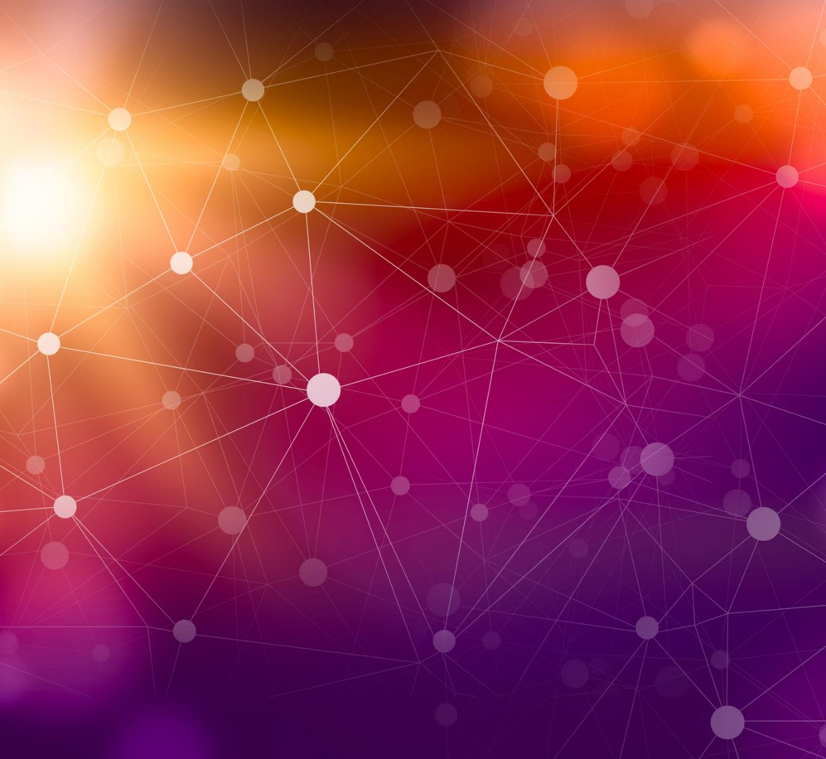
Pagerank algorithm
Author: Patryk Wrona
Subject: “Social Networks and Recommendation Systems”
Notes:
13/12/2022

Slide 2
Algorithm background
A cited paper introduced a large-scale web search engine – in order to respond to increasing demands of growing number of users, pagerank algorithm was used.
Pagerank goals as one of the system’s features:
Improved Search Quality
Academic Search Engine Research
The graph of the entire web consisting of links of the web is an important resource – we can make use of such a data structure thanks to calculated pagerank.
The described algorithm is based on: http://infolab.stanford.edu/pub/papers/google.pdf
13 December 2022

Slide 3
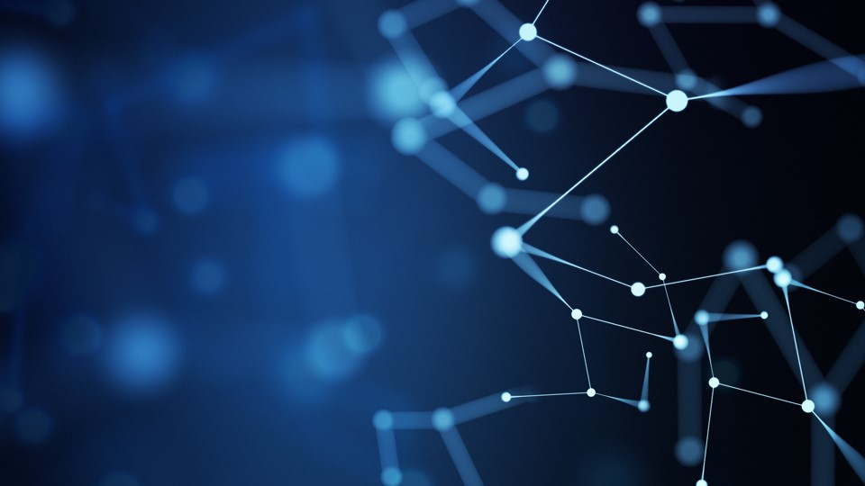
Pagerank
This metric is widely used to “measure” the relative importance of a websites within their set of hyperlinked pages.
All webpages together constitute a network.
The described algorithm is based on: http://infolab.stanford.edu/pub/papers/google.pdf
13 December 2022
Notes:
13/12/2022

Slide 4
Algorithm description
Page A is associated with T_1, …, T_n pages linking to page A. Indeed, their relationship could be associated with digraph data structure.
C(A) is defined as the number of links going out of A – outgoing vertices.
d – an arbitrary parameter from the interval [0,1] – usually 0.85
In order to calculate given page (e.g A) pagerank (PR), one must calculate all pageranks associated with the pages pointing at A – that is why it is a relative measure.
The described algorithm is based on: http://infolab.stanford.edu/pub/papers/google.pdf
13 December 2022

Slide 5
Algorithm features
All pageranks of A, T_1, …, T_n form a probability distribution.
Pagerank of A is the eigenvector corresponding to the largest eigenvalue of the standardized matrix of the web.
Pagerank of A can be calculated iteratively as it consists of calculating the respective websites’ pageranks until the convergence of the algorithm.
The described algorithm is based on: http://infolab.stanford.edu/pub/papers/google.pdf
13 December 2022

Slide 6
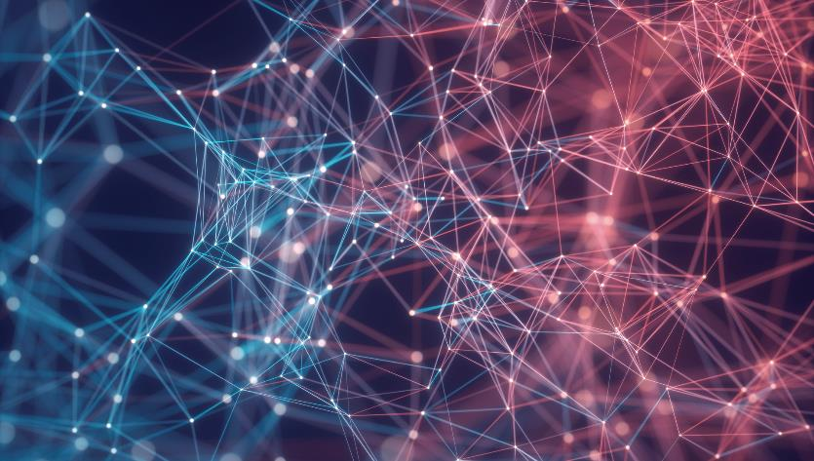
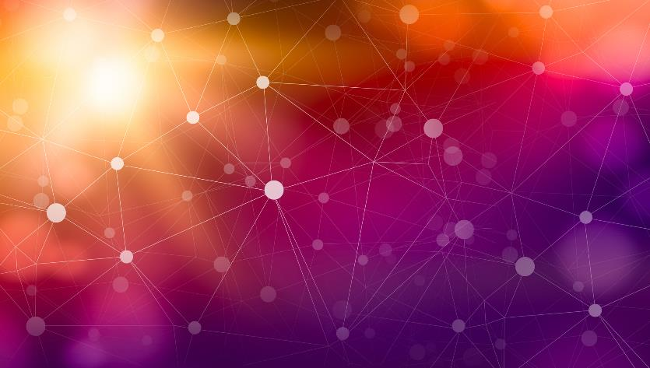
Thank You for your attention
13 December 2022

